Slide 1

Quarantine Lifestyle Analysis
A study on how our environment and choices affect our outlook.

Slide 2

What’s in our Data?
A survey was used to collect data on outlooks, lifestyle, and environment. US Census data brings economic insights on our survey group.
Personal Outlooks
Quantitative Data
Capability : ability to accomplish
Energy : will to start/finish tasks
Agency : control over your day
Community: connection to others
Priority : you decide what you do
Lifestyle data – hours spent working, sleeping, reading, etc.
Environmental data – number of household members, number of pets, working from home, etc.
US Census Income data – 2019 Census data provided insight to average total income based on age group

Slide 3

Project Goals
What are our data questions?
Identify any lifestyle elements that have a strong relationship with one’s happiness.
Examine the differences between particularly happy and unhappy people.
See how age plays a role on one’s happiness, and if income is tied to it.

Slide 4
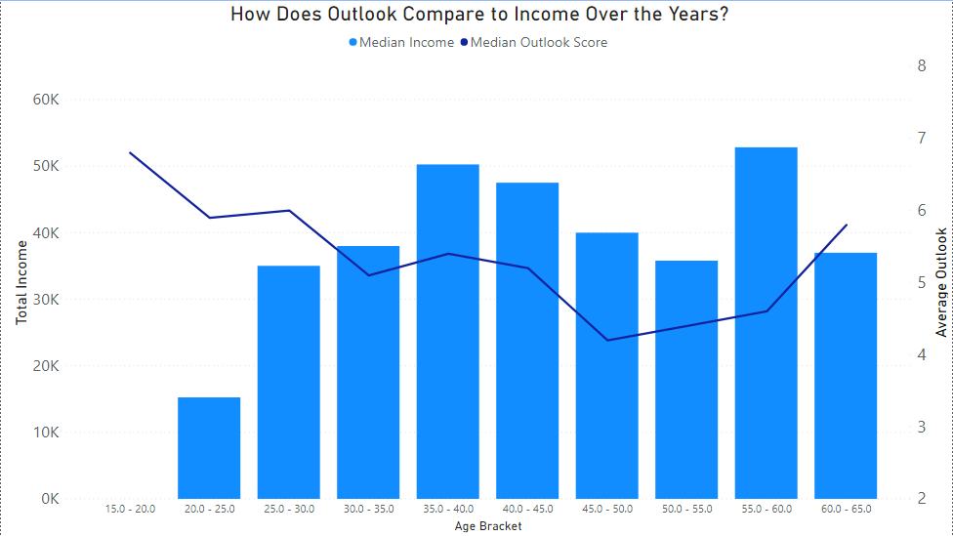
Income, Age, & Outlook

Slide 5
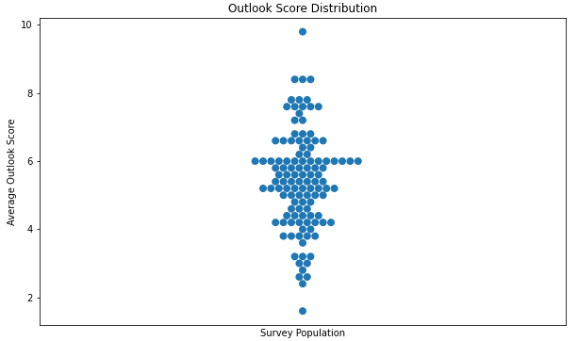

Population Outlook Scores
Every participant’s average outlook score has been mapped below:

Slide 6
How are Outlooks Measured?
In the survey, a series of questions were used to specifically measure how one feels regarding an aspect of life. These were summarized into single word definitions for quick comparisons.
Outlook Questions
Capability : Do you currently feel like you are more rested, or overworked? (0-10, Rested/Overworked)
Energy : How do you feel going throughout your day? (0-10, Tired/Energized)
Agency : Do you feel like you decide how your day goes? (0-10, Disagree/Agree)
Community: Do you feel that the quarantine has made you more or less connected to others? (0-10, Lonely/Connected)
Priority : Do you feel like you decide what’s on your To-do list? (0-10, Disagree/Agree)

Slide 7
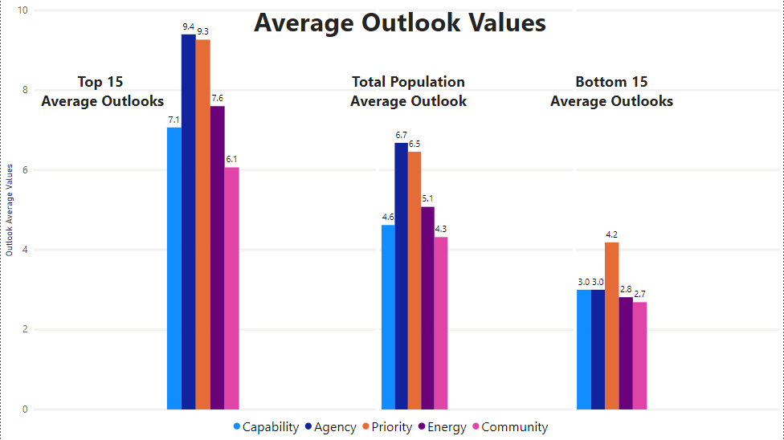

Slide 8
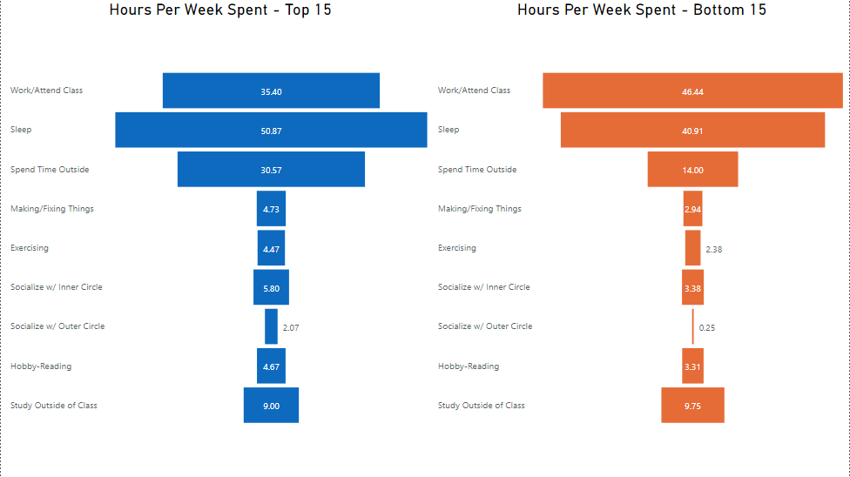
High Outlook vs Low Outlook Lifestyles

Slide 9



Low Correlations
The Things that Don’t Affect Your Outlook
Number of people you live with-
How many people do you currently live with? -0.007
Time spent studying-
How many hours a week do you currently spend studying outside of class? 0.038
Working at least 15 hours/week-
Do you work or attend class for at least 15 hours per week? -0.012
Living with another person-
Do you live with other people? -0.041
Working from home-
Do you currently work from home? 0.03
Spending time outside-
Do you spend time outside? -0.046

Slide 10




Thank You
Alan Brunlinger
+1 615 438 8738
abrunlinger@gmail.com
https://github.com/abrunlinger/

